Slide 1

OctopusTale
Case Studies

Slide 2

1
Simuka Football:
Creating The Ultimate Fan Engagement Platform
Mobile App - Android & iOS

Slide 3

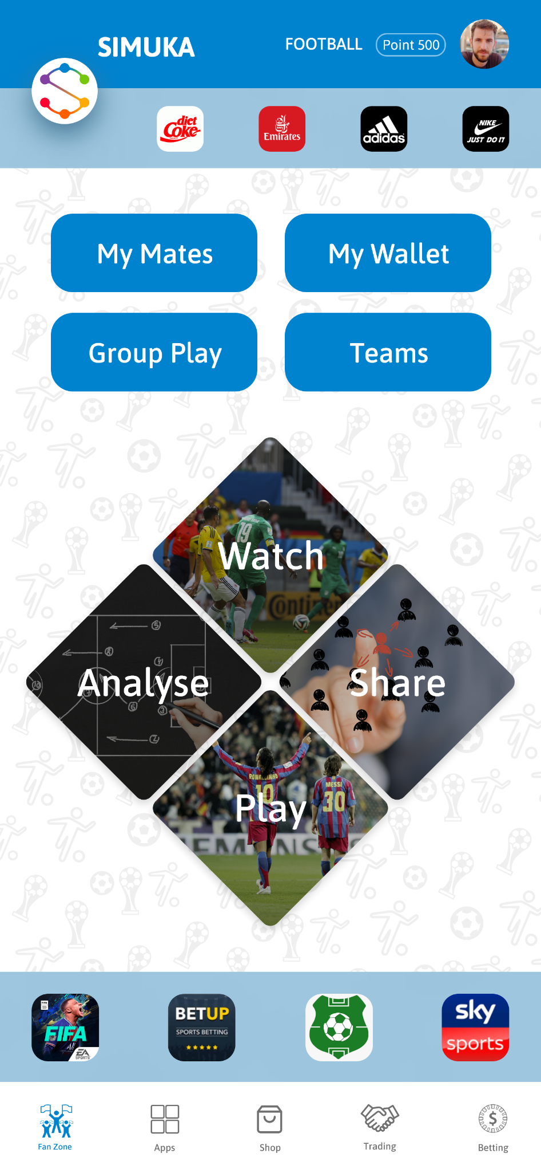
Introducing Simuka Football, a beautifully designed mobile app that enhances fan engagement like never before.
Simuka Football is more than just a platform; it's an immersive experience. With features like live match streaming, real-time events, social posting, and chat groups, fans can connect with each other like never before.
Our team has meticulously crafted this app to meet global standards while ensuring a seamless user interface and experience.

Slide 4
Gamified Experience
Live Streaming
Community Chat
Zero Rated Access
Earn Rewards
Fan Engagement

Slide 5
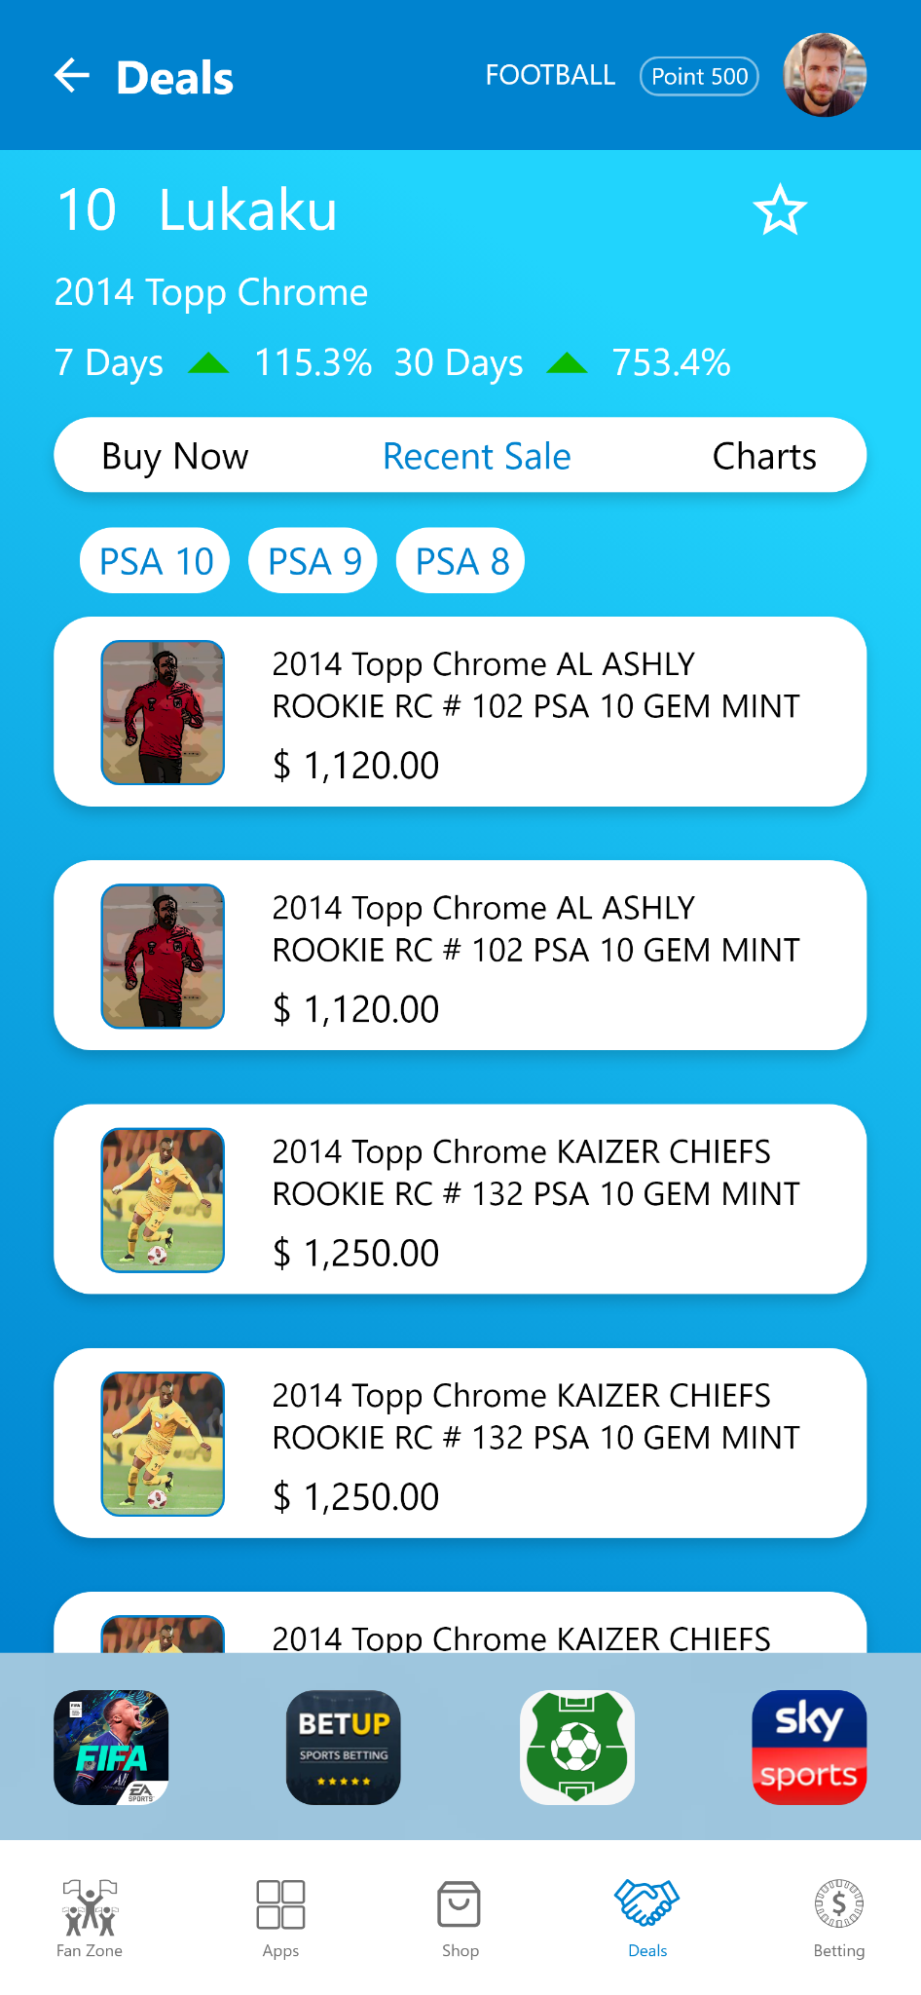
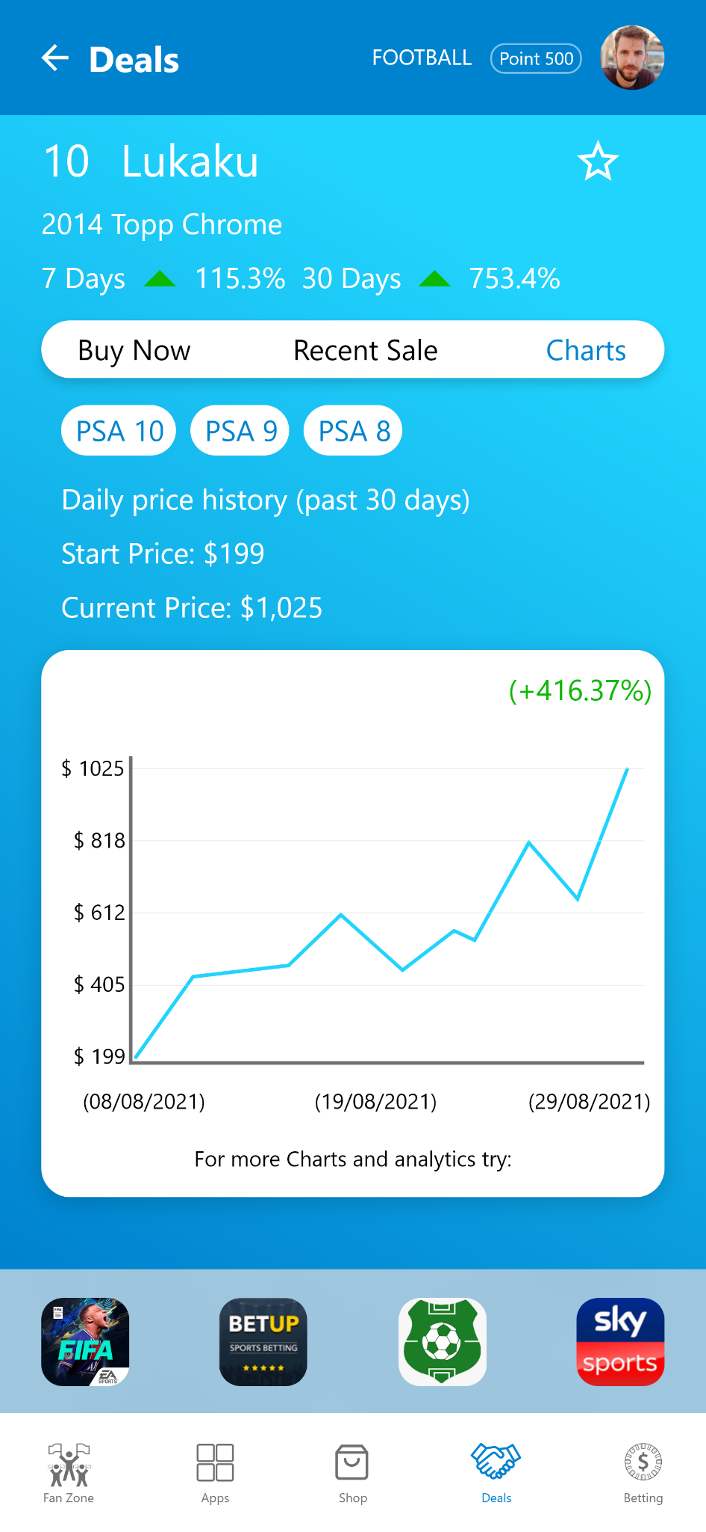
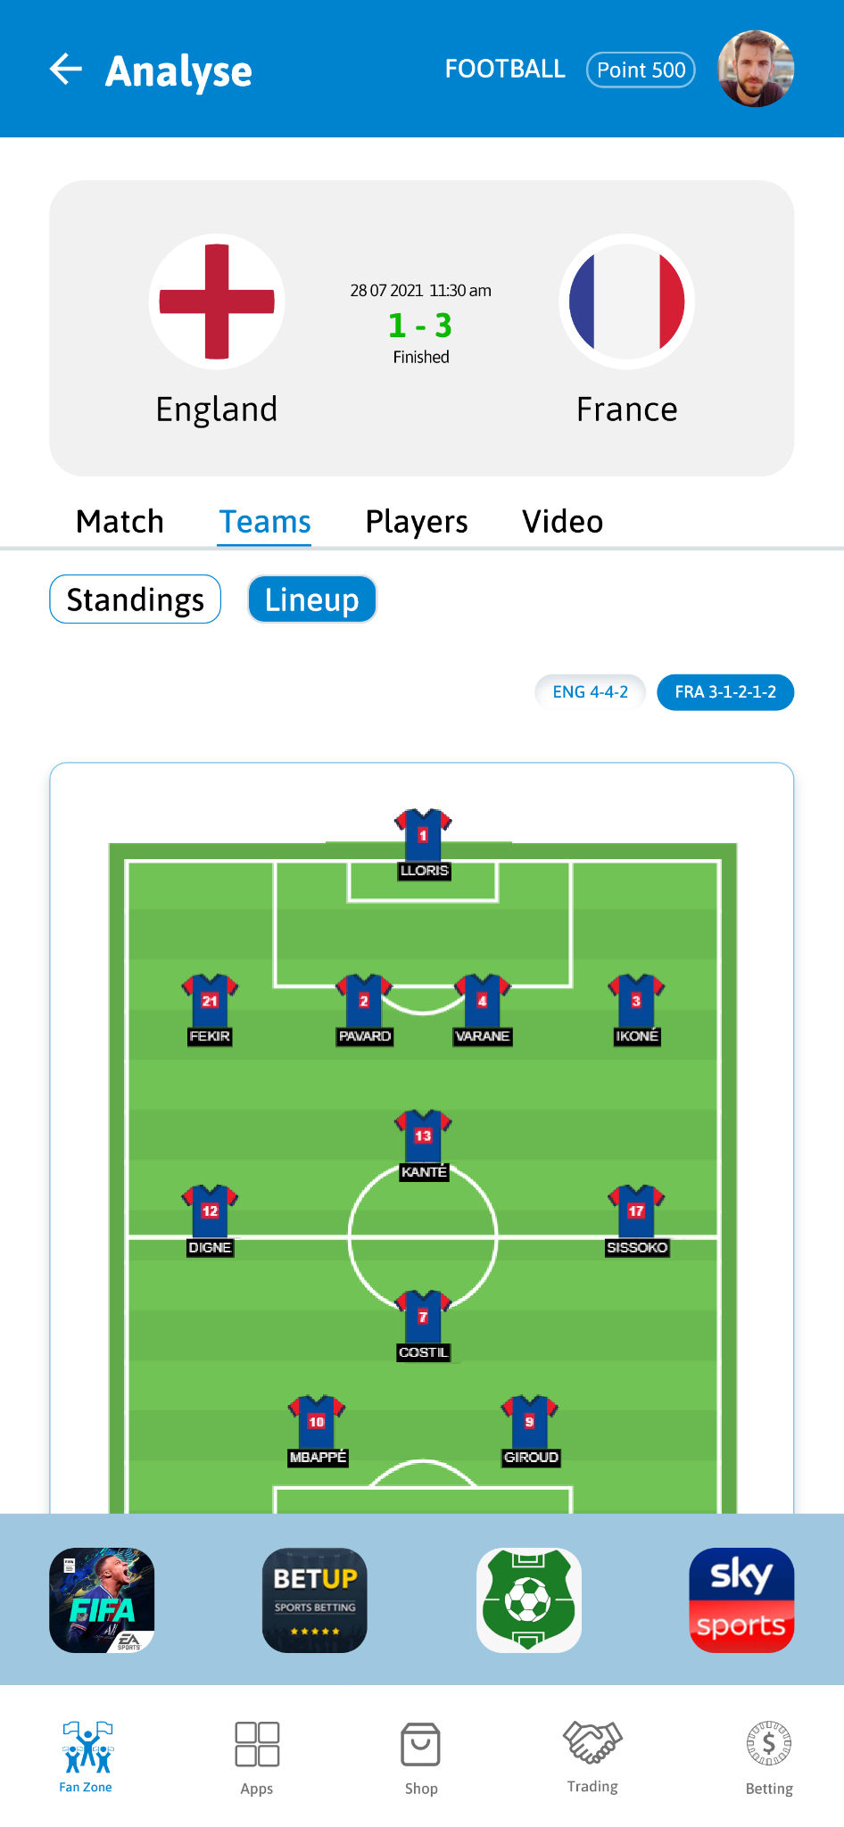
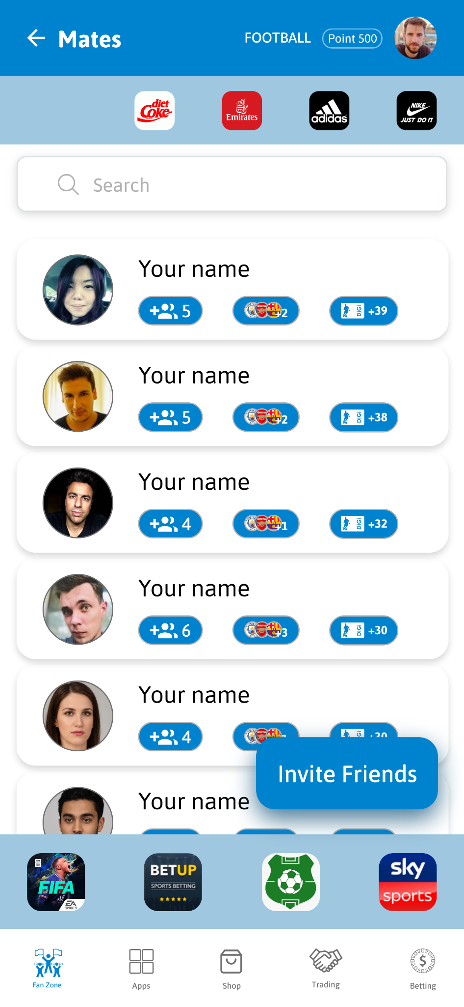
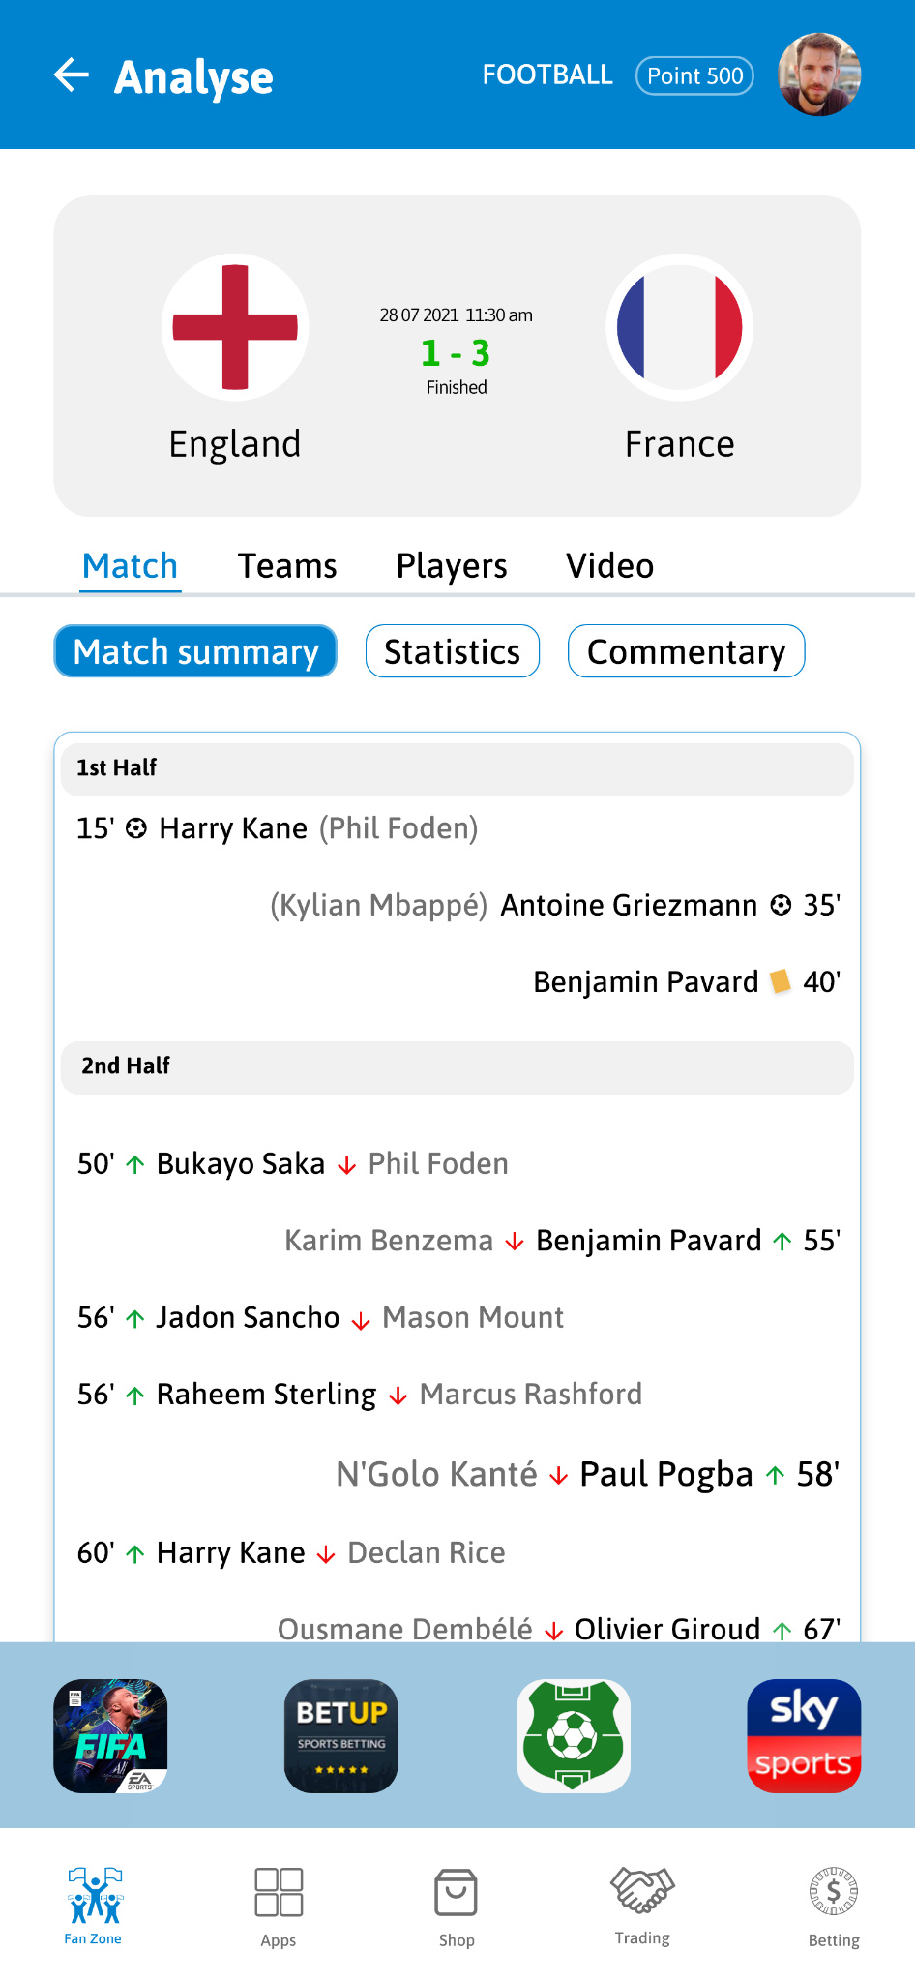
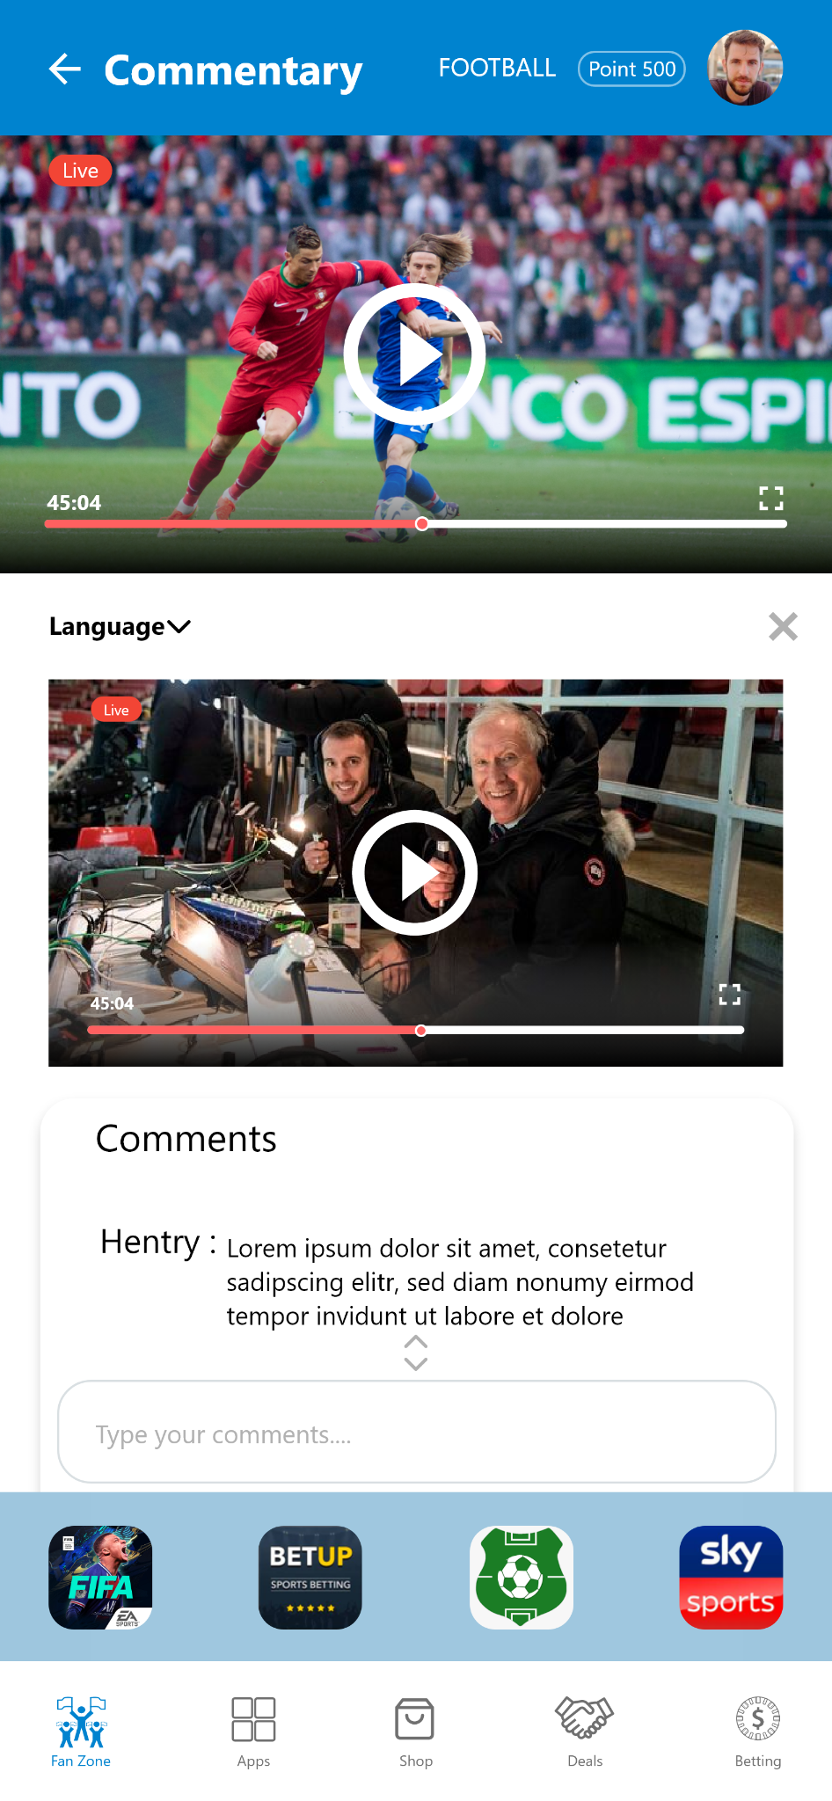

Slide 6

FF - FootiFocus
Crafting a bidding and fan engagement platform
Mobile App - Android
2

Slide 7
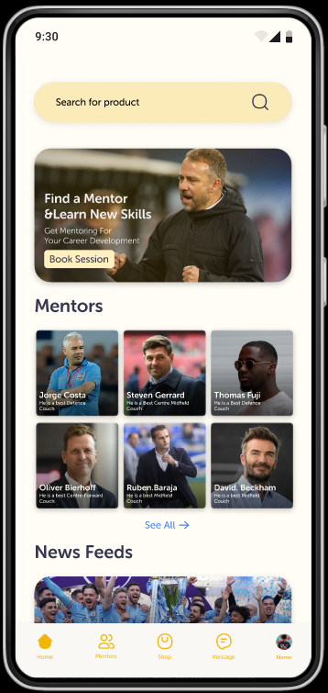
Introducing the ultimate mobile app for football enthusiasts!
FF combines real-time bidding, personalized e-mentoring, and social engagement. Users can also bid on authentic used jerseys and gear. Experience a seamless interface, expert guidance, and connect with a vibrant community.
Our dedicated team has developed this app to meet the highest standards of quality and functionality, ensuring it stands out in the global market.

Slide 8
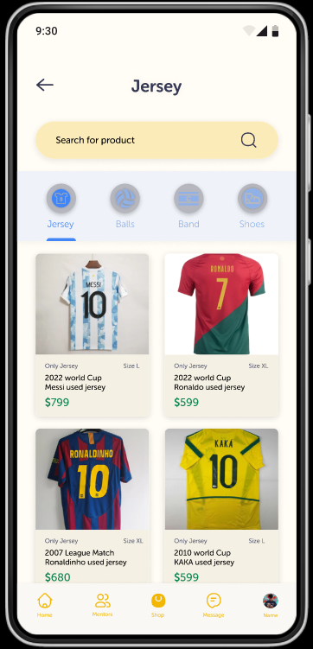
Gamified Experience
Sports Memorabilia
Community Chat
Bidding Experience
E -Mentoring
Fan Engagement

Slide 9
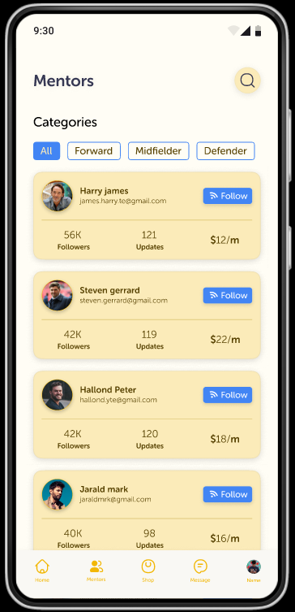
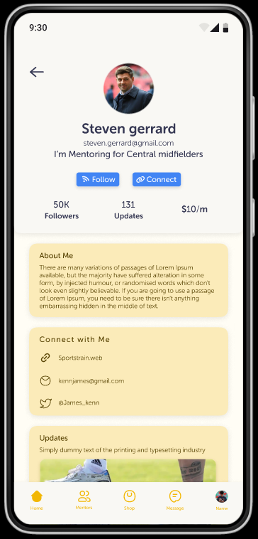
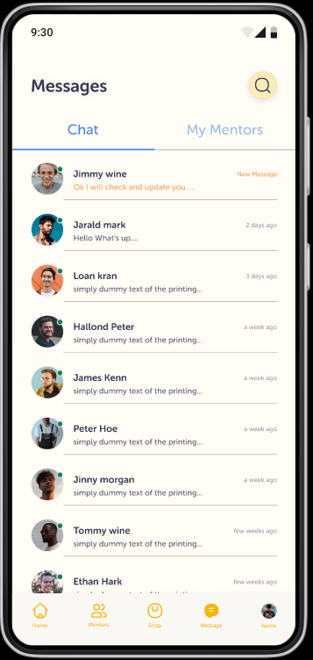

Slide 10

Skatey
Designing an e-mentoring and fan engagement platform
Mobile App - Android
3

Slide 11

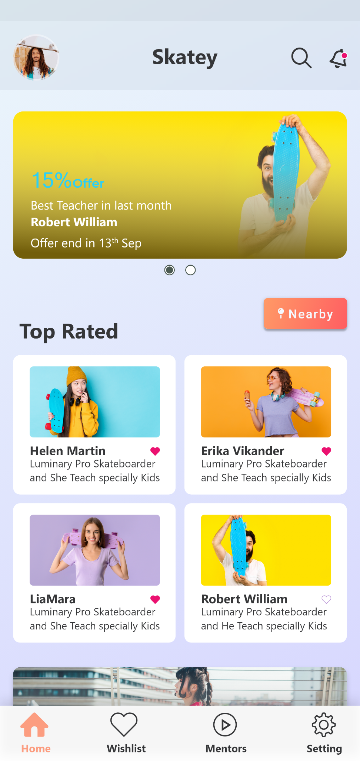
Meet the epic mobile app for skate lovers!
Skatey is a fan engagement platform crafted by skate enthusiasts for skate enthusiasts. The platform offers live e-Mentoring and a Group Mentoring platform, aimed at fostering the growth of future champions.
Partnership with renowned Canadian skater Jessy Jean Bert, adding excitement and expertise to the community.
Our dedicated team has developed this app to meet the highest standards of quality and functionality, ensuring it stands out in the global market.

Slide 12
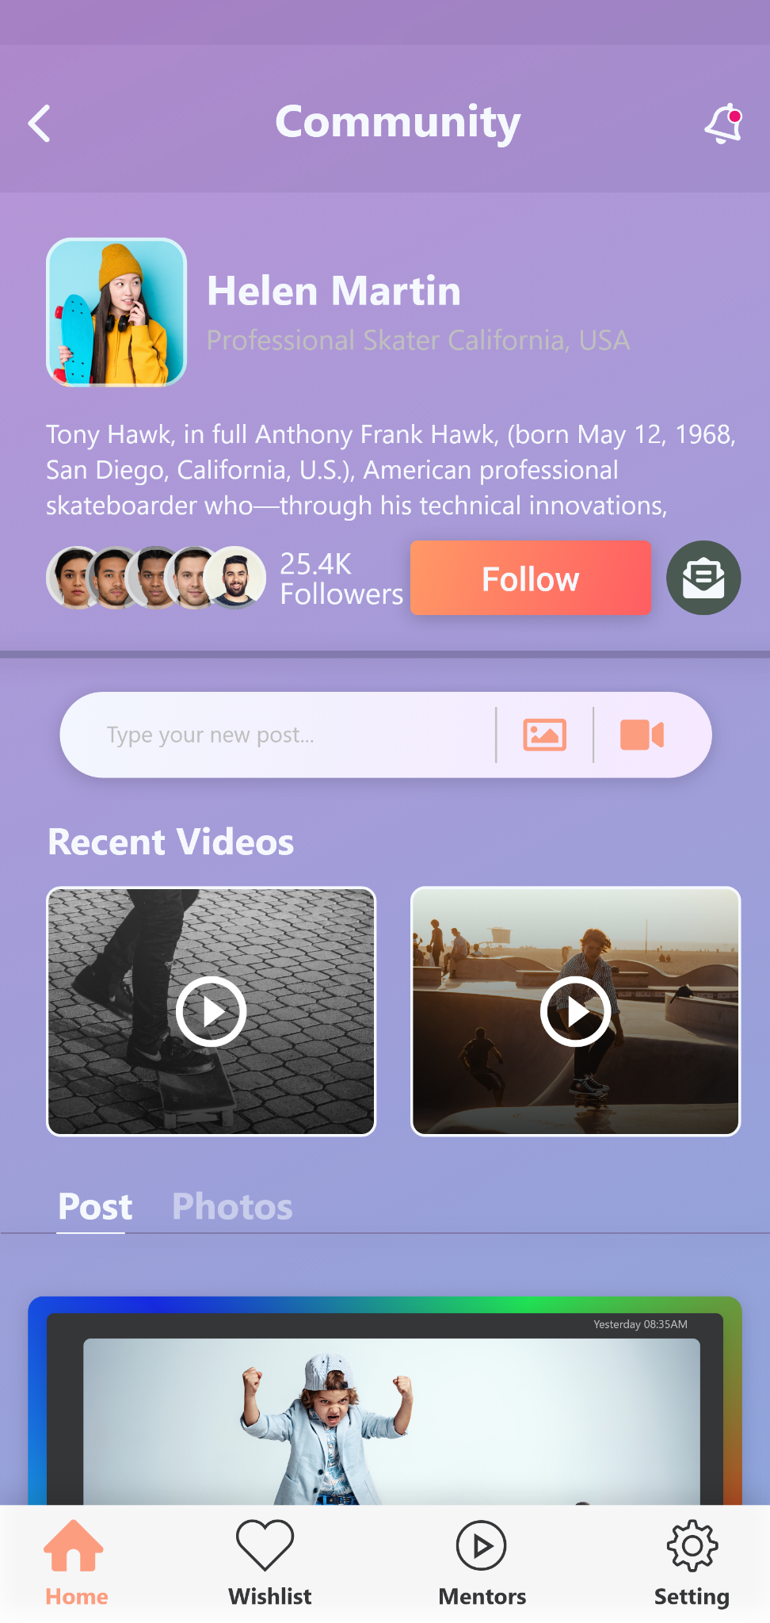
E -Mentoring
Content Sharing
Fan Engagement
Community Chat

Slide 13
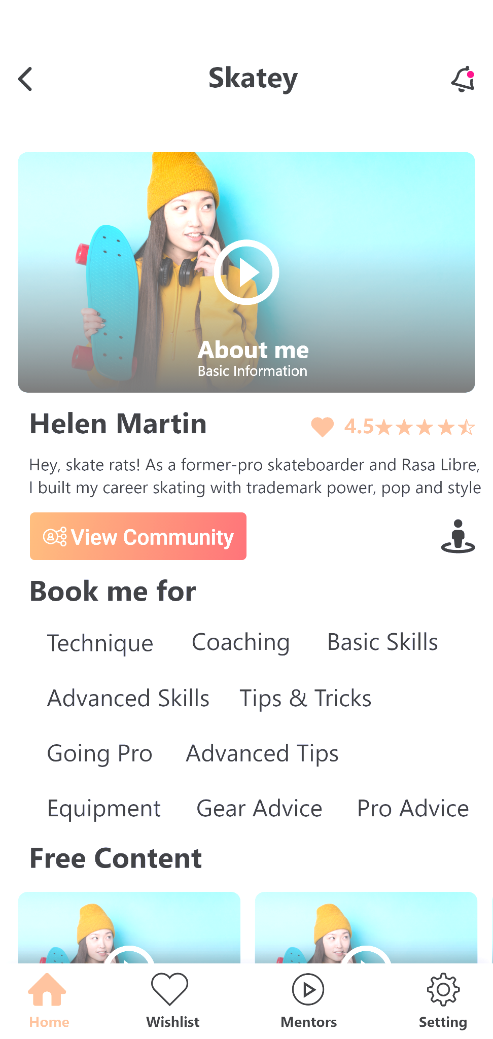
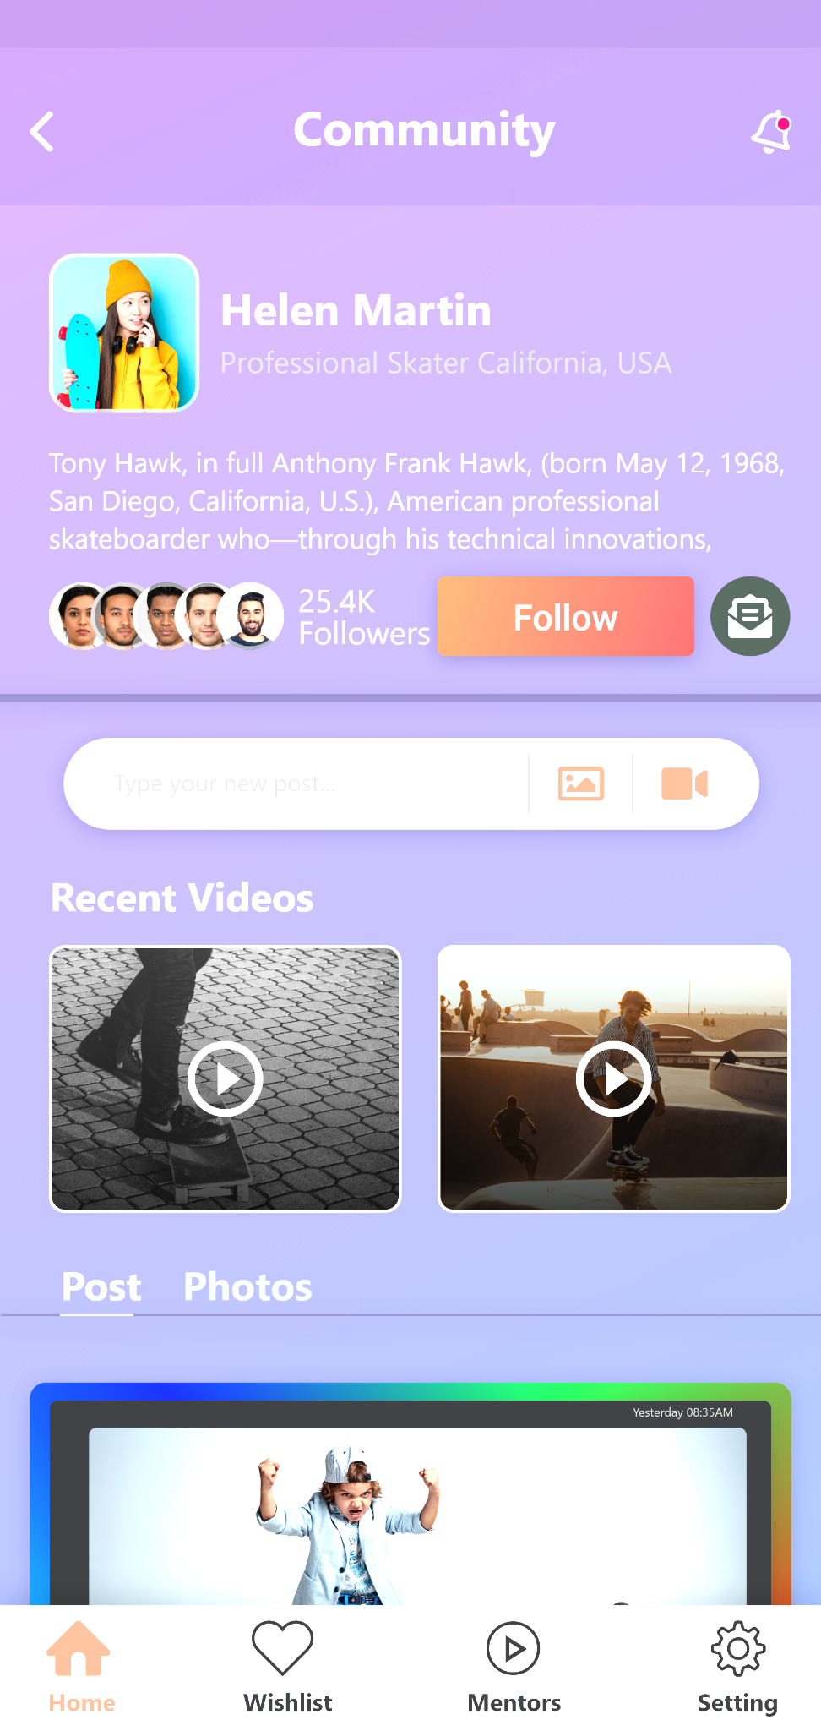
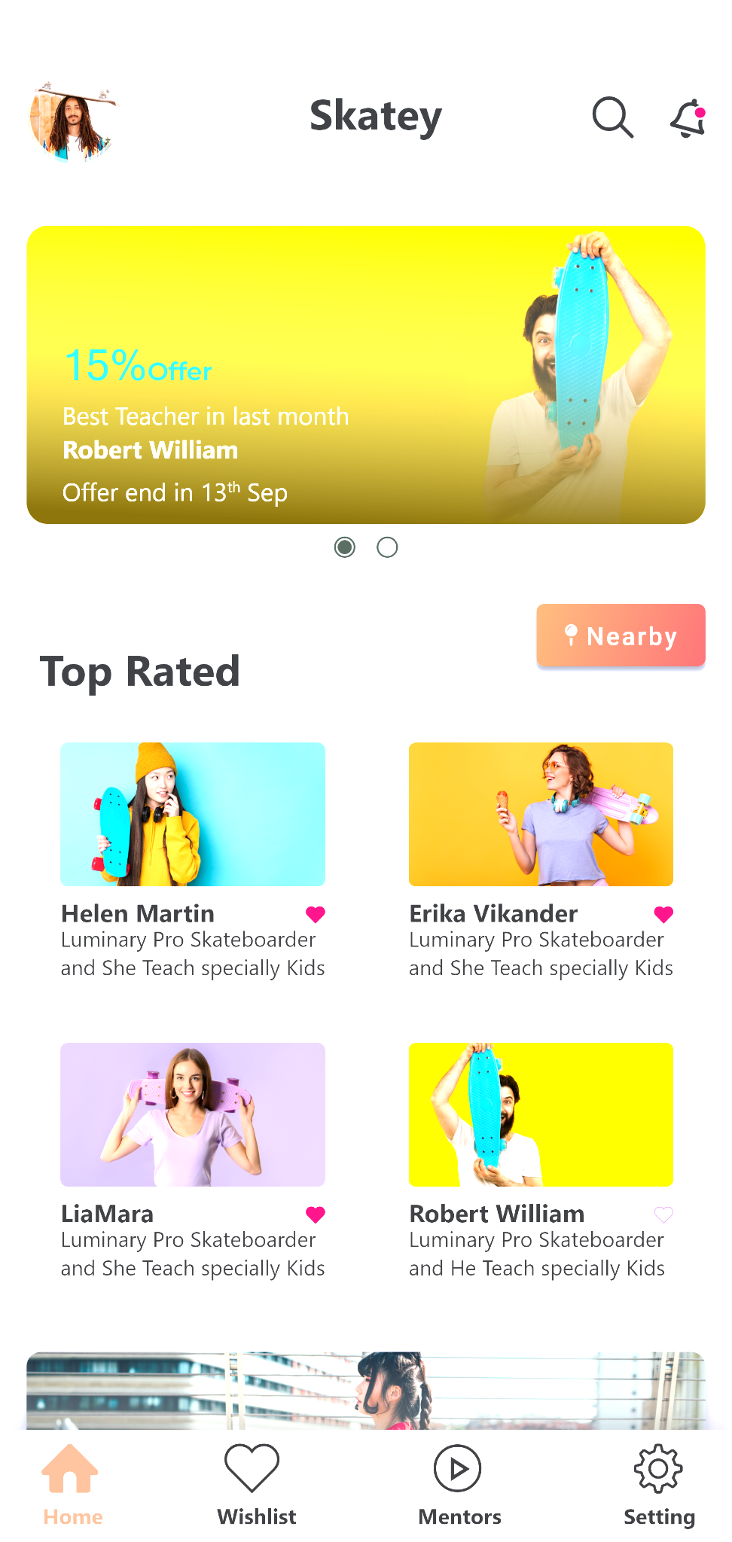
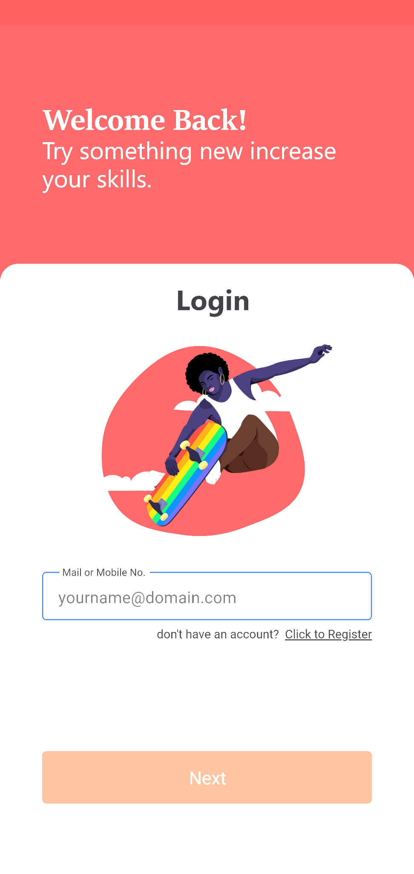
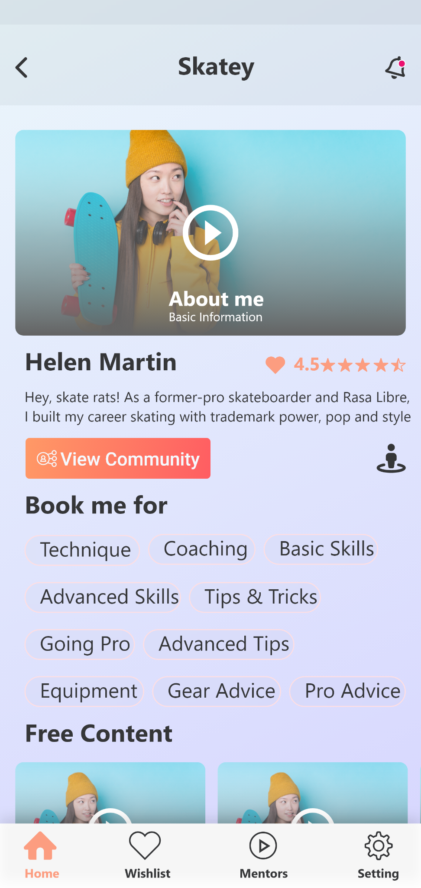
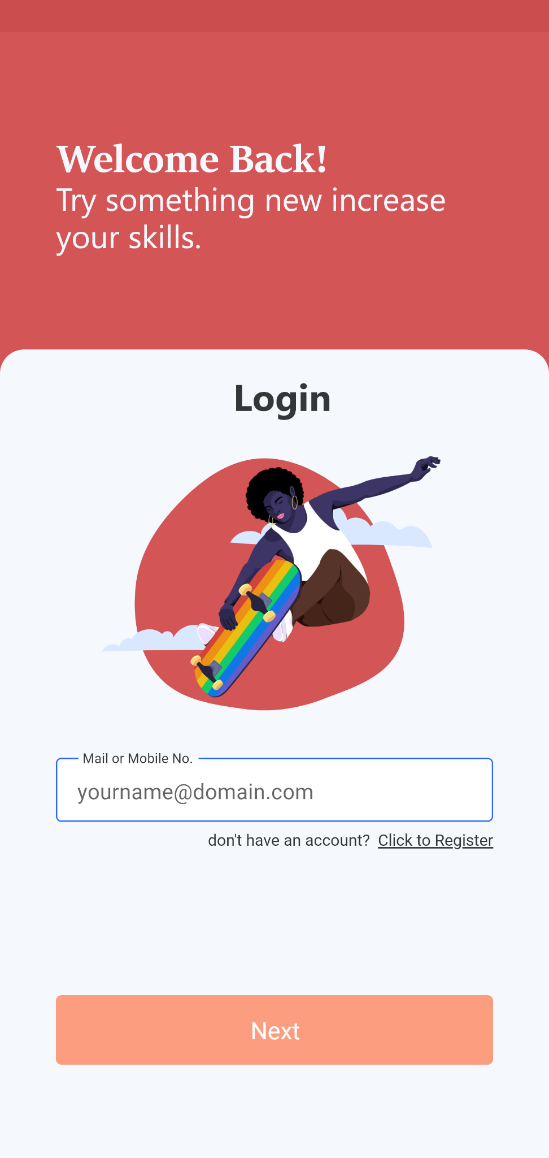

Slide 14

4
iCrick
Crafting AI Driven E-Mentoring Platform
Mobile App - Android

Slide 15
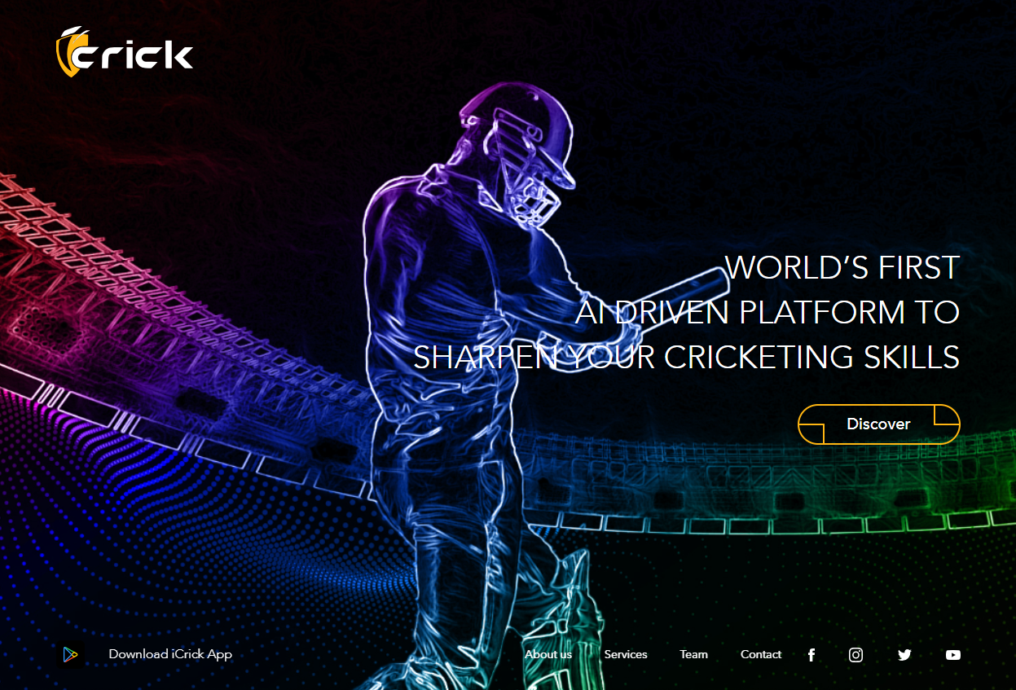
Introducing iCrick, an amazing mobile app for e-mentoring, with the power of AI
The world’s leading Artificial Intelligence enabled application for cricket mentorship and access to vast amount of intellectual property content on cricket.
Our team has meticulously crafted this app to meet global standards while ensuring a seamless user interface and experience.

Slide 16
E - Mentoring
Mentoring by leading international players and coaches from across the world on a one-on-one video chat.
Direct Coaching
Get coached by the experts from our mentors’ panel of international players.
White labeling
Use our proven technology products to keep record of your matches and player's performance.
Live Score
Mentoring by leading international players and coaches from across the world on a one-on-one video chat.

Slide 17

KasiD
Customizing a Food Delivery Platform
Mobile App - Android
Admin Panel Web App
5

Slide 18


KasiD, an amazing food delivery platform
KasiD is a custom-built food delivery platform that caters specifically to the diverse needs of South African communities.
The platform connects local customers to their favorite restaurants, offering a seamless and personalized experience in the food delivery industry.

Slide 19
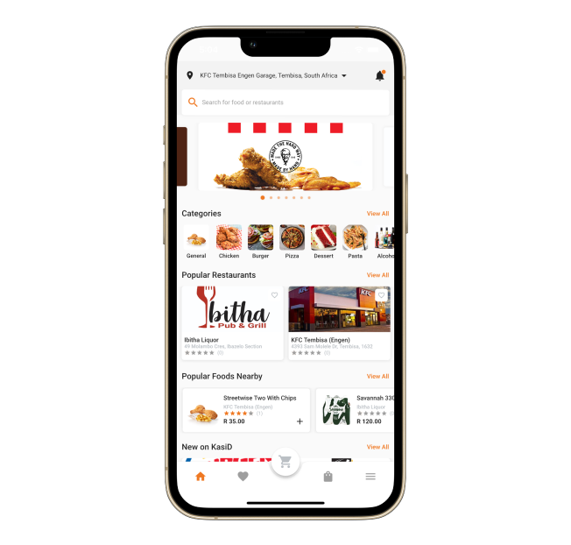
Customer App
User-Friendly Interface
Personalized User Profiles
Secure Payments
Ratings & Reviews
Push Notifications

Slide 20
Restaurant App
Menu Management
Order Management
Inventory Tracking
Delivery Management
Analytics & Reporting
Promotions & Discounts

Slide 21
Admin Web App
User Management
Order Oversight
Restaurant Management
Payment & Transaction Control
Promotions & Marketing
Analytics and Reports

Slide 22
Thank You!

